Slide 1
UMAP
Uniform Manifold Approximation and Projection
= DIMENSION REDUCTION

Slide 2
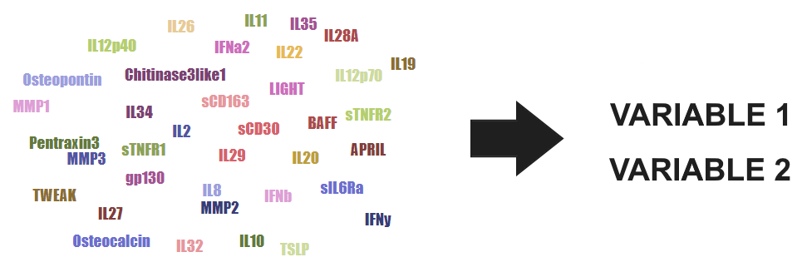
What is dimension reduction?

Slide 3
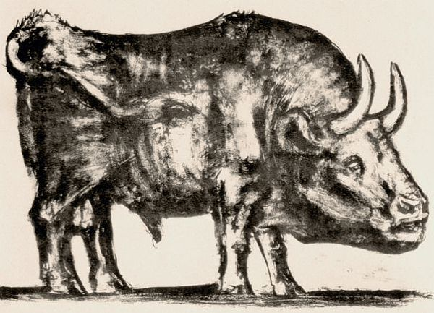
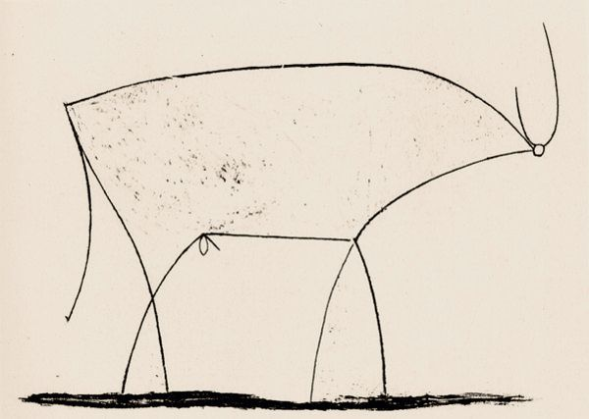
Picasso’s Bull (1945)

Slide 4
Two types of dimension reduction
Global structure
Local structure
PCA
LargeVis
MDS
?
t-SNE
Sammon
mapping
Isomap
Laplacian
eigenmaps

Slide 5
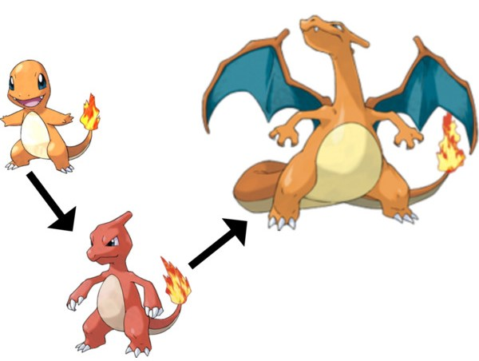
(simplified) evolution of dimension reduction
PCA (1901)
UMAP (2018)
t-SNE (2008)

Slide 6

Handwritten numbers (MNIST)

Slide 7
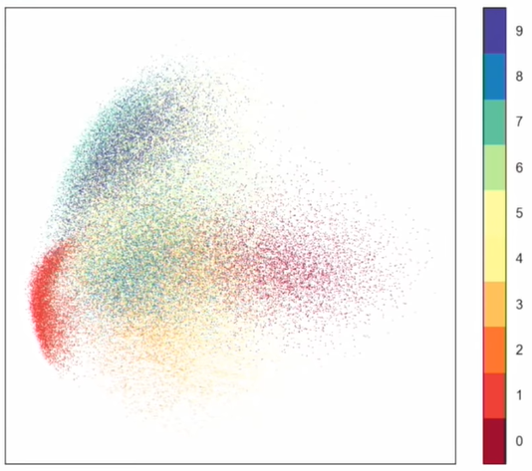
PCA on MNIST

Slide 8
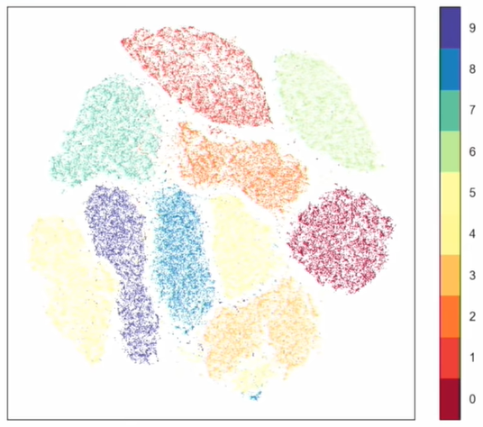
t-SNE on MNIST

Slide 9
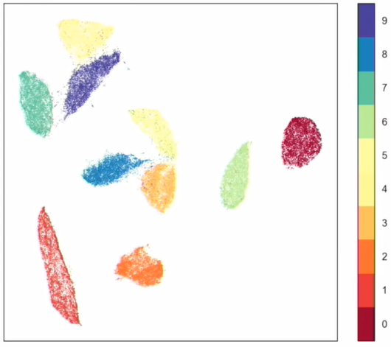
UMAP on MNIST

Slide 10
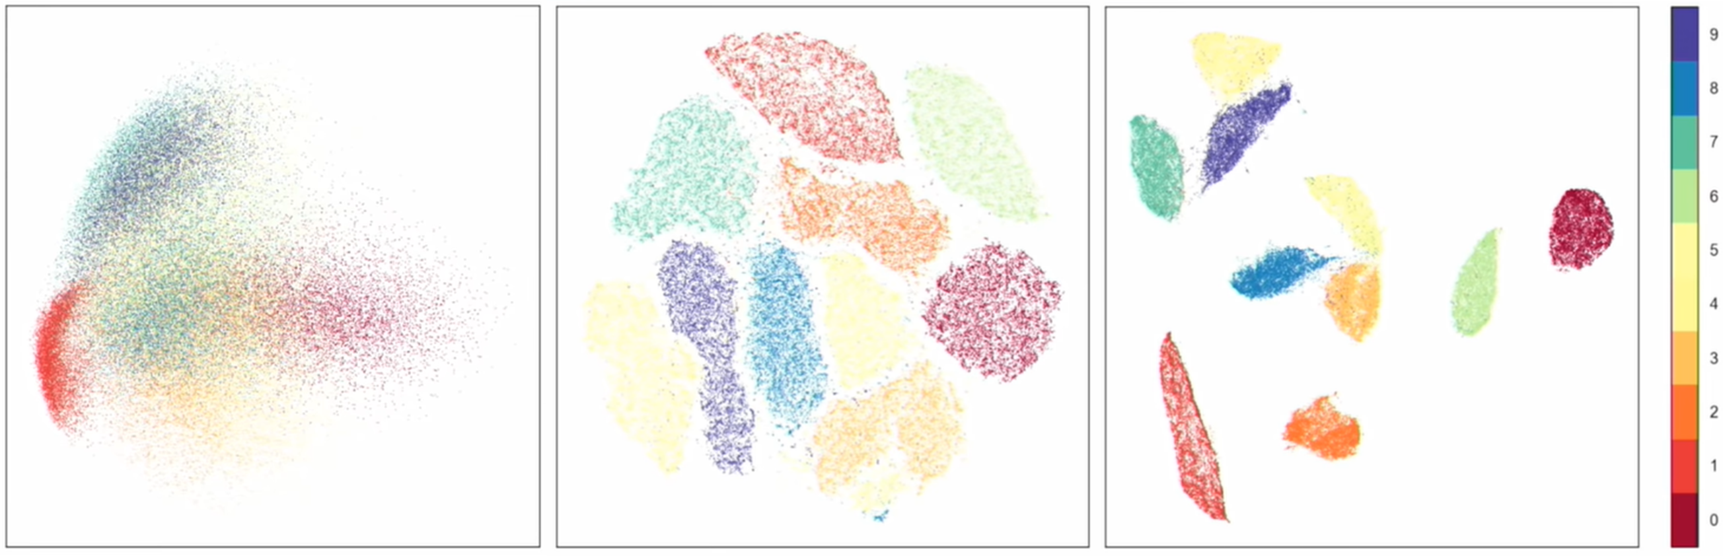
PCA
t-SNE
UMAP
4
1
6
9
9
7
7
2
5
0
8
9
0
3
6
0
8
5
1
4
3
1
2
Notice 4, 7, 9 and 3, 5, 8 + similarities between PCA and UMAP.

Slide 11
How UMAP differs from t-SNE
UMAP shows global structure
Faster, like 10 times faster
Less random
Many metrics (at least 21)
Supports supervision and semi-supervision
Grounded in solid math (algebraic topology)

Slide 12
Math in UMAP
Construct a fuzzy high-dimensional graph of the data
Represent this graph in lower dimensions
See figure 3 at: https://pair-code.github.io/understanding-umap/

Slide 13
Three parameters (+ more)
Parameter Sensible range A reasonable default # of neighbors 5 to 50 15
min distance 0.001 to 0.5 0.1
Metric anything Euclidean?

Slide 14
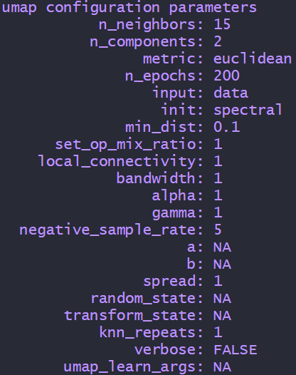

Slide 15
Let’s play
See figures 1, 4 and 5 at:
https://pair-code.github.io/understanding-umap/

Slide 16
Real-life R-example (see umap.R)

Slide 17
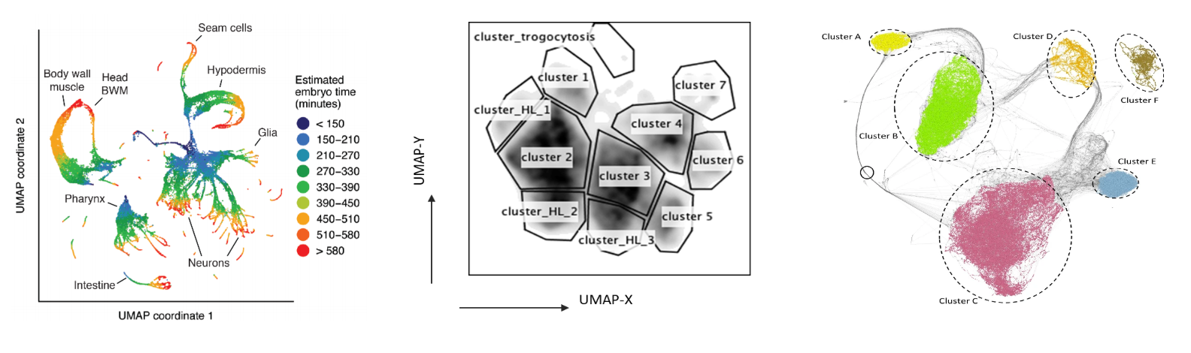
Plots from published papers

Slide 18
Keep these in mind with UMAP
Parameters matter
Axes might be meaningless
Even noise has structure
There is a random element to UMAP
It’s fast

Slide 19


Slide 20
Useful links
https://umap-learn.readthedocs.io/ (excellent documentation)
https://arxiv.org/abs/1802.03426 (original UMAP paper)
https://github.com/lmcinnes/umap (git repository for UMAP)
https://www.youtube.com/watch?v=nq6iPZVUxZU (30 min introduction)
https://pair-code.github.io/understanding-umap/ (UMAP interactive)
https://towardsdatascience.com/how-exactly-umap-works-13e3040e1668 (in-depth comparison of UMAP and t-SNE)
http://yann.lecun.com/exdb/mnist/ (MNIST dataset of numbers)
https://duhaime.s3.amazonaws.com/apps/umap-zoo/index.html (zoo)

Slide 21
Sources for pics and video
http://ffden-2.phys.uaf.edu/webproj/212_spring_2017/Andrew_Adler/Physics_of_Pokemon/evolution.html (pokemon pic)
https://www.youtube.com/watch?v=nq6iPZVUxZU (MNIST plots)
https://towardsdatascience.com/how-exactly-umap-works-13e3040e1668 (motorcycle pic)
10.1126/science.aax1971 (tissue plot)
papers.ssrn.com/sol3/papers.cfm?abstract_id=3531071 (cell plot)
10.1007/s00371-019-01673-y (temporal plot)
https://www.youtube.com/watch?v=nCk8dyU7zUM (primes video)

Slide 22
